Slide 1
Instrument 2.0 Update
Lamar Moore

Slide 2
Overview
Motivation
Prototyping
Implementation
Rollout and Challenges
Future

Slide 3
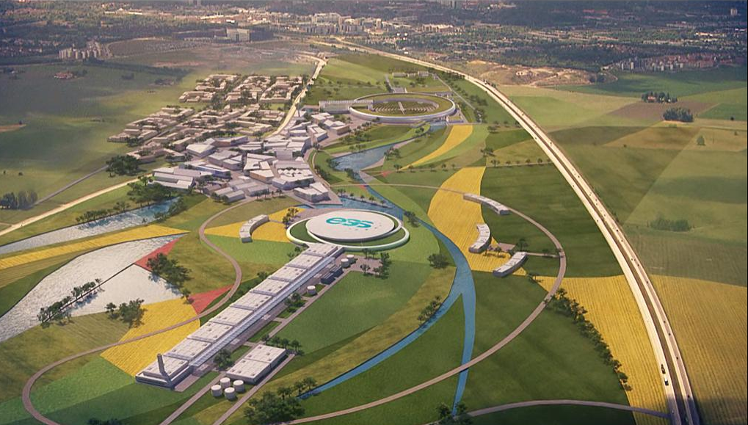
Motivation
Collaboration with the ESS and the decision to use the Mantid Framework as the tool for live data reduction presented a few major concerns about the current implementation of the virtual instrument in Mantid.
Complexity – can the virtual instrument accurately represent experiment complexities for proposed instruments?
Performance Demands – is Mantid performant enough to meet the live reduction challenge presented by the ESS?
Instrument Definition – is the current scheme and syntax rich enough to support new instruments? (e.g. voxels)

Slide 4

Motivation
Simon Heybrock (ESS) undertook a Performance Analysis survey of Mantid which was written in 2015.
Performance Analysis Report 2015 - Simon Heybrock

Slide 5

Motivation
Survey Findings (Section 7):
Major performance bottleneck around geometry access for data reduction. SANS2D used as case study.
getDetector() – instrument copies, map lookups.
getPos() – requires traversal of instrument tree every time and ParameterMap lookup.
ParameterMap access and COW mechanism suboptimal.
Detectors identified by detid_t which is
typedef int32_t
Caching mechanism hindered by map lookups.
Hugely inefficient for read access.

Slide 6
Motivation
Survey Findings (Section 7):
No easy way to include moving instruments.
Instrument is duplicated for every workspace which would have performance implications in a distributed scenario.

Slide 7
Motivation
Requirements gathering exercise 2016 which involved all of the facilities.
Performance – should be at least 10x faster for reads. Highlighted the possibility of using SoA approach as opposed to the current AoS.
Scanning (Moving Instruments) – Step, Scan, Triple Axis
Threading - should be threadsafe for reading, does not need to be for writing.
Visualization – (Instrument View)

Slide 8
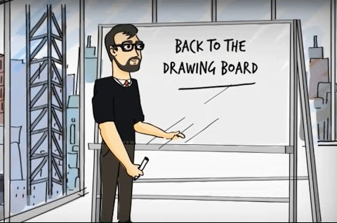
Motivation
Evaluation of the current state of the virtual instrument in Mantid against the requirements gathered lead to the decision for a rewrite of the virtual instrument in Mantid which was labelled Instrument 2.0.
Final approval of the requirements document kicked off a set of milestones for the project which included prototyping and scope setting.

Slide 9

Prototyping
Set out in Milestone 1.0. Investigation into the current state of the Instrument 1.0 functionally.
Owen Arnold steered the prototype against the activity outputs high-risk and high priority items developed first.
Large scale prototyping effort (2 rounds). Iterative, several prototypes were discarded.
Isolated from Mantid Framework.
Extensive Benchmarking.
No performance compromises.
Prototyping

Slide 10
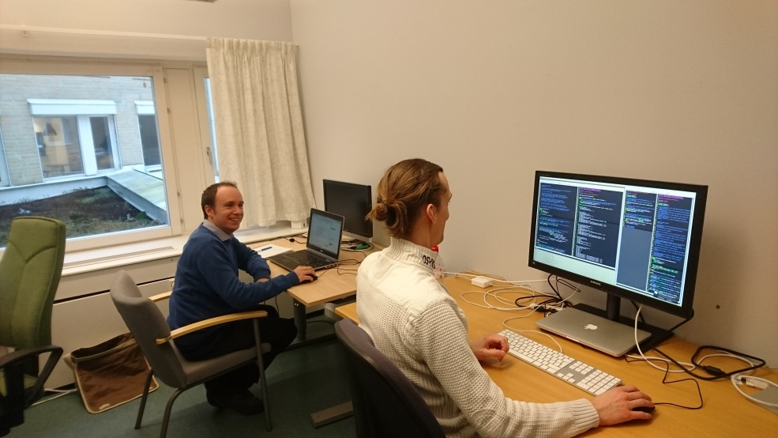
Prototyping
Investment from ILL for scanning due to a need for scanning support.
This came at the end of the prototyping period.
ESS provided bulk effort design and infrastructure changes.
ILL provided testing against real instruments and high-level functionality.
Prototyping
Ian Bush (left) and Simon Heybrock at the Scanning Workshop in Lund February 2017

Slide 11
Prototyping
Outputs Beamline::SpectrumInfo, Beamline::ComponentInfo and Beamline::DetectorInfo which represent Instrument 2.0. There is no actual Instrument 2.0 entity.
Two orders of magnitude improvement in speed for reads.
An order of magnitude improvement in speed for writes.
Beamline provides native support for asynchronous and synchronous scans of detectors and synchronous scans of component assemblies. Flat tree data structure of new layers made this possible.
Prototyping

Slide 12
Implementation
Mantid::Beamline has no dependence on Mantid::Kernel. The Eigen library was used in the prototypes and preserved for use in Instrument 2.0.
There is no inheritance structure as with Component. Some Type information is however still preserved e.g. Beamline::ComponentType. Allows leveraging some faster customised approaches to some calculations e.g bouding box calculations.
Structure of Arrays approach used to provide layers of access.
Implementation

Slide 13
Implementation
Instrument 1.0 Storage
Detector 1
Detector 2
Detector 3
position : V3D
position : V3D
position : V3D
rotation : Quat
rotation : Quat
rotation : Quat
is_masked : bool
is_masked : bool
is_masked : bool
…
…
…
Further effects
Only offsets are stored.
No proper copy mechanism. Parameter Maps used instead
Store pointers to Components in, for example, CompAssembly as std::vector
Array of Structures Approach

Slide 14
Implementation
Instrument 2.0 Storage
DetectorInfo
Absolute values stored
std::vector<Eigen::vector3d>
std::vector<Eigen::quaterniond>
COW wrapped. No ParameterMap needed.
std::vector<bool>
…
Structure of Arrays approach
More data in the cache and fewer misses for most scenarios. Overall much, much faster access.
ComponentInfo is similar and also stores “Flat Tree” for navigation

Slide 15
Implementation
Instrument Access Layers
Introduces a new paradigm for instrument access via indexing. No more map lookups for things like position and rotation.
ComponentInfo::position(index)
SpectrumInfo is a view of the instrument from a spectral perspective e.g.
SpectrumInfo::isMonitor(index) SpectrumInfo::spectrumDefinition(index)
DetectorInfo contains an interface for dealing specifically with detectors.
DetectorInfo::isMasked(index)
DetectorInfo::setPosition(index, position)
DetectorInfo::l2(index)
ComponentInfo contains an interface for dealing with generic components (detectors included).
ComponentInfo::root()
ComponentInfo::children(index)
ComponentInfo::detectorsInSubtree(index)
Implementation

Slide 16
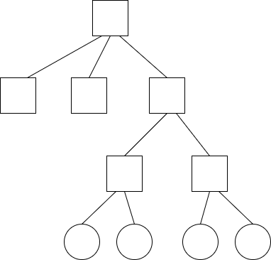
Implementation
root
comp1
sample
source
subcomp1
subcomp2
det2
det2
det3
det4

Slide 17
Implementation
root
comp1
sample
source
subcomp1
subcomp2
0
det2
det2
det3
det4

Slide 18
Implementation
root
comp1
sample
source
subcomp1
subcomp2
0
1
det2
det2
det3
det4

Slide 19
Implementation
root
comp1
sample
source
subcomp1
subcomp2
0
1
2
det2
det2
det3
det4

Slide 20
Implementation
root
comp1
sample
source
subcomp1
subcomp2
0
1
2
3
det2
det2
det3
det4

Slide 21
Implementation
root
comp1
sample
source
subcomp1
4
subcomp2
0
1
2
3
det2
det2
det3
det4

Slide 22
Implementation
root
comp1
sample
source
subcomp1
4
5
subcomp2
0
1
2
3
det2
det2
det3
det4

Slide 23
Implementation
root
6
comp1
sample
source
subcomp1
4
5
subcomp2
0
1
2
3
det2
det2
det3
det4

Slide 24
Implementation
root
7
6
comp1
sample
source
subcomp1
4
5
subcomp2
0
1
2
3
det2
det2
det3
det4

Slide 25
Implementation
root
8
7
6
comp1
sample
source
subcomp1
4
5
subcomp2
0
1
2
3
det2
det2
det3
det4

Slide 26
Implementation
ComponentInfo
9
root
Higher level components always have higher indices than children.
8
7
6
comp1
sample
source
subcomp1
4
5
subcomp2
0
1
2
3
det2
det2
det3
det4

Slide 27
Implementation
Relationship Between ComponentInfo and DetectorInfo
ComponentInfo
9
root
8
7
6
comp1
sample
source
subcomp1
4
5
subcomp2
DetectorInfo
0
1
2
3
det2
det2
det3
det4

Slide 28
Implementation
Relationship Between ComponentInfo and DetectorInfo
ComponentInfo
9
root
ComponentInfo and DetectorInfo contain the same indices for detectors.
8
7
6
comp1
sample
source
subcomp1
4
5
subcomp2
DetectorInfo
0
1
2
3
det2
det2
det3
det4

Slide 29
Implementation
Within the codebase there currently exist 2 layes:
Beamline::ComponentInfo
Beamline::DetectorInfo
Beamline::SpectrumInfo
and
Geometry::ComponentInfo
Geometry::DetectorInfo
Geometry::SpectrumInfo
Currently all *info objects are in compatibility mode and are built by parsing Instrument 1.0 in the InstrumentVisitor

Slide 30
Rollout
Due to extensive effort from Simon Heybrock, DetectorInfo rolled out first. Required work with parts of Instrument 1.0 in complex ways. Whole dev team helped upgrade Mantid codebase to use DetectorInfo.
ComponentInfo rolled out second alongside better mechanisms for Instrument 1.0 -> Instrument 2.0 conversions. Second phase allowed a clean-up for the first.
Performance test monitoring was performed weekly to ensure changes did not an adverse impact on Mantid performance.
Minimized issues by delaying merging until the start of dev cycles.
Rollout

Slide 31
Rollout
Some performance issues needed to be resolved urgently for users who were dependent on nightly builds.
Performance related bounding box calculation were solved thanks to efforts by Owen Arnold which required many new optimizations in the face of design challenges.

Slide 32
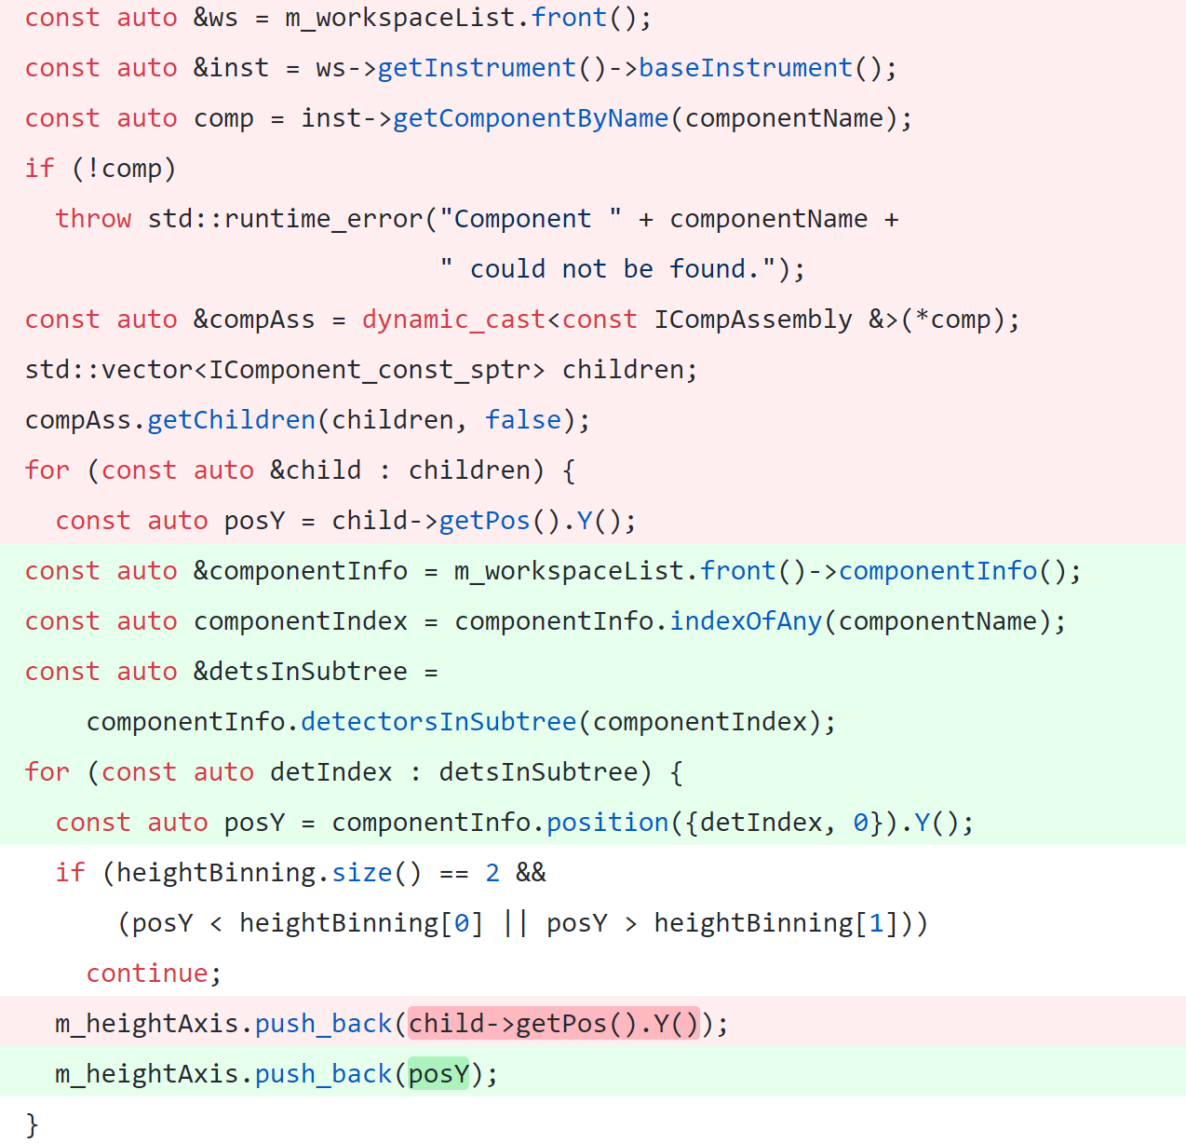
Rollout
Refactoring Example SumOverlappingTubes

Slide 33
Future
At this time Instrument 2.0 work has stopped. Some features are now out of scope due to lack of resources:
No definition of beam paths.
New file formats for representing geometry.
Extended IDF aspects.
Still need to purge and write parameter map, no new file formats or mechanisms there.
Compatibility mode must be removed Geometry::*info.
Future

Slide 34
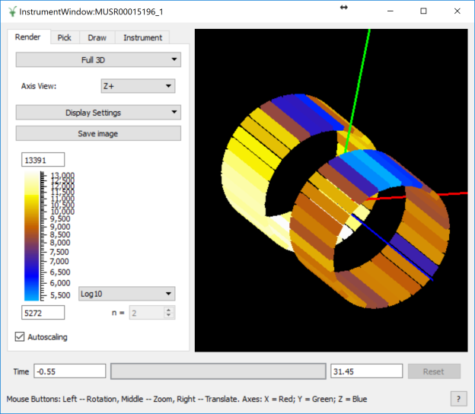
Future
Instrument View
ESS Requirement for visualisation meant we needed to look into the instrument view performance.
Survey carried out in 2017 on performance bottlenecks in the Instrument View. Found 30% of loading time spent on dynamic_casts. > 50% of time spent in MatrixWorkspace::getInstrument.
Major refactoring work has started on the instrument view to make use of the new instrument access layers.
The actor mechanism ComponentActor, ComponentAssemblyActor etc. have been entirely stripped out.
Up to 10x loading speed-up so far for large instruments like WISH.

Slide 35
The End

Slide 36
Questions?

